Slide 1
Two stage Op-Amp 65nm
Viet Ngo
HCM City, Oct 15th 2024

Slide 2
Content
Design Two-stage Opamp
Testbench
Result
Layout

Slide 3
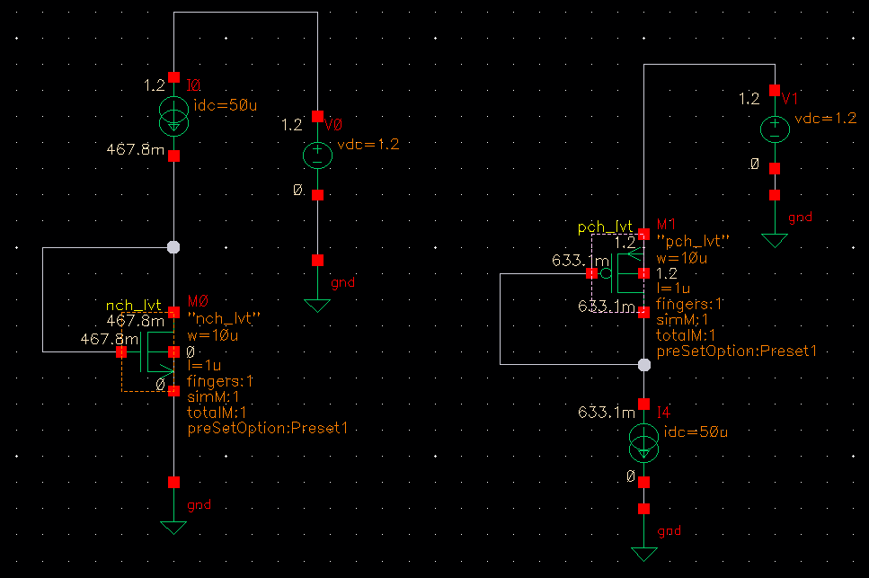
Find UpCox and UnCox

Slide 4



Find UpCox and UnCox
From schematic above, we find DC_OP of NMOS and PMOS.
$$U_{n}C_{ox}{(\frac{W}{L})}_{n}={Betan}_{eff}→U_{n}C_{ox}=\frac{3.537m}{10}=353.7u≈354u$$
$$U_{p}C_{ox}{(\frac{W}{L})}_{p}={Betap}_{eff}→U_{p}C_{ox}=\frac{1.218m}{10}=121.8u≈122u$$
$$U_{n}C_{ox}≈354u$$
$$U_{p}C_{ox}≈122u$$
Vthn = Vthp $≈$ 0.3V

Slide 5
Specification of OpAmp
DESIGN PARAMETERS |  | SPECIFICATIONS
VDD |  | 1.2V
Output mode |  | Single ended
Gain |  | > 60dB
Pharse Margin (PM) |  | > 60 degree
CMRR |  | > 60dB
Unity gain bandwidth |  | > 80MHz
Power consumption |  | < 1mW
Slew rate |  | 40V/us
Cap load |  | 1pF
ICMR |  | 0.6 - 1
PVT | Process | 5 process of MOS
 | Voltage | 1.08V-1.32V
 | Temperature | -40˚C to 125˚C

Slide 6
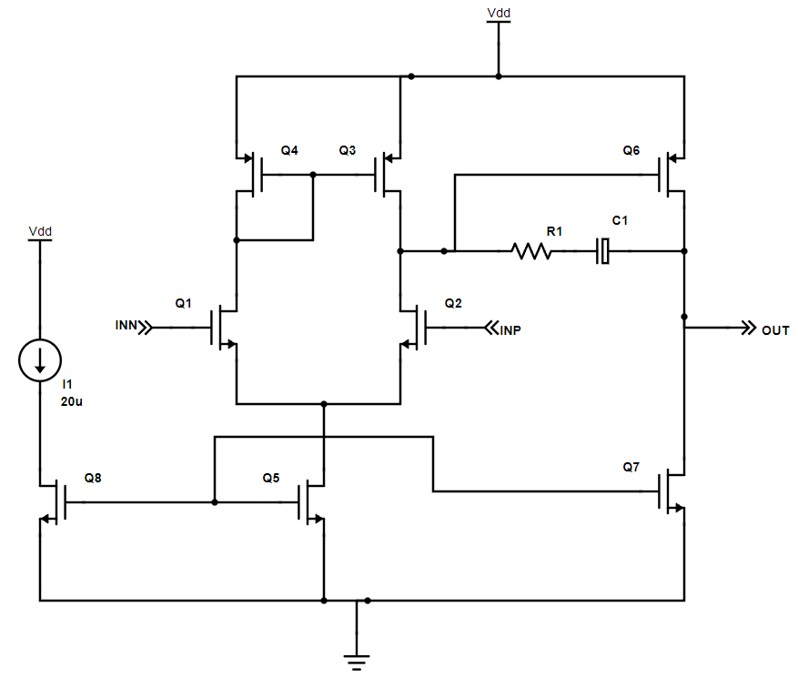
Schematic

Slide 7
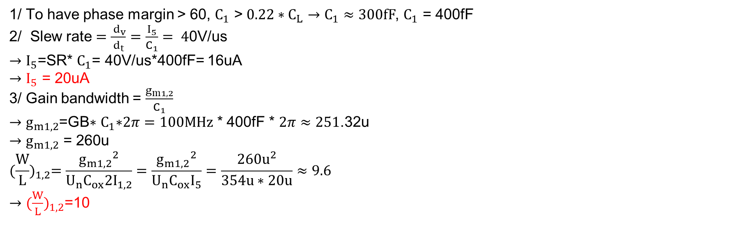
Design Procedure
1/ To have phase margin > 60, $C_{1}$ > ${0.22∗C}_{L}→C_{1}≈300fF$, $C_{1}$ = 400fF
  2/ Slew rate $=\frac{{ d}_{v}}{d_{t}}=\frac{I_{5}}{C_{1}}= 4$0V/us
              $→$ $I_{5}$=SR* $C_{1}$= 40V/us*400fF= 16uA
              $→$ $I_{5}$ = 20uA
3/ Gain bandwidth = $\frac{g_{m1,2}}{C_{1}}$
$→$ $g_{m1,2}$=GB$∗$ $C_{1}\text{∗}2π=100MHz$ * 400fF * $2π≈251$.32u
$→$ $g_{m1,2}$ = 260u
$${(\frac{W}{L})}_{1,2}=\frac{{g_{m1,2}}^{2}}{U_{n}C_{ox}2I_{1,2}}=\frac{{g_{m1,2}}^{2}}{U_{n}C_{ox}I_{5}}=\frac{{260u}^{2}}{354u∗20u}≈9.6$$
$→$ ${(\frac{W}{L})}_{1,2}$=10

Slide 8
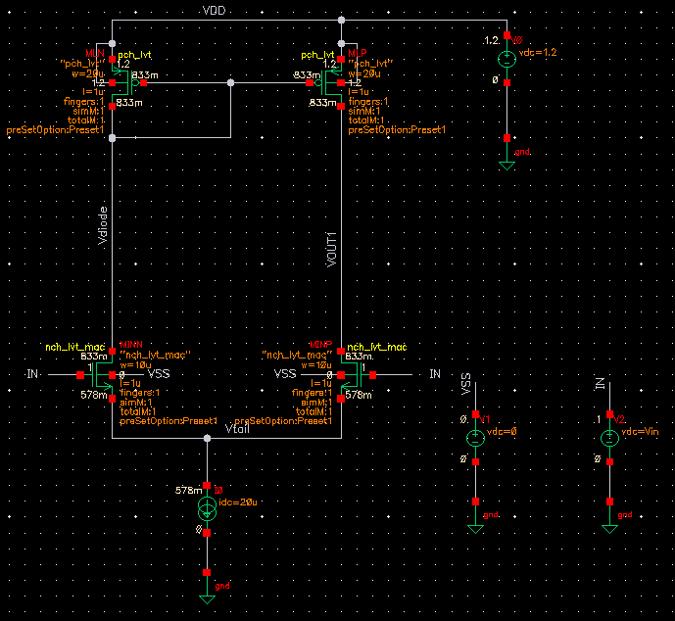


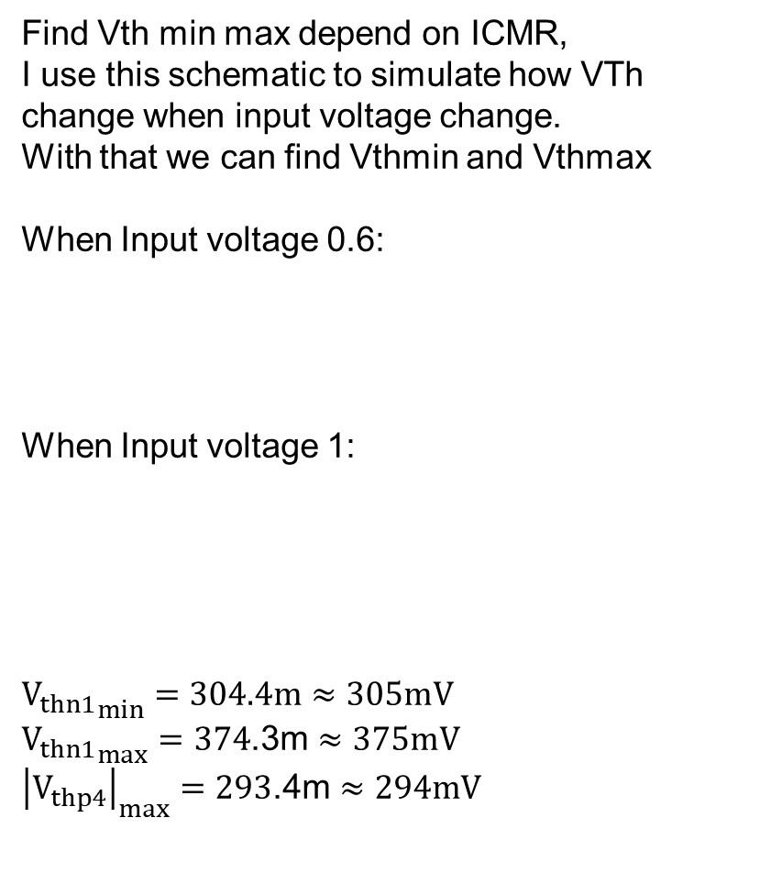
Design Procedure
Find Vth min max depend on ICMR,
I use this schematic to simulate how VTh change when input voltage change.
With that we can find Vthmin and Vthmax
When Input voltage 0.6:
When Input voltage 1:
$${V_{thn1}}_{min}=304.4m≈305mV$$
${V_{thn1}}_{max}=374$.3m $≈375mV$
${\left|V_{thp4}\right|}_{max}=293$.4m $≈294mV$

Slide 9
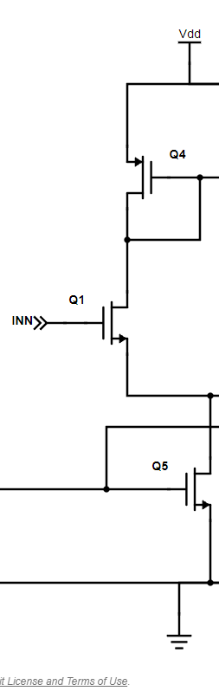
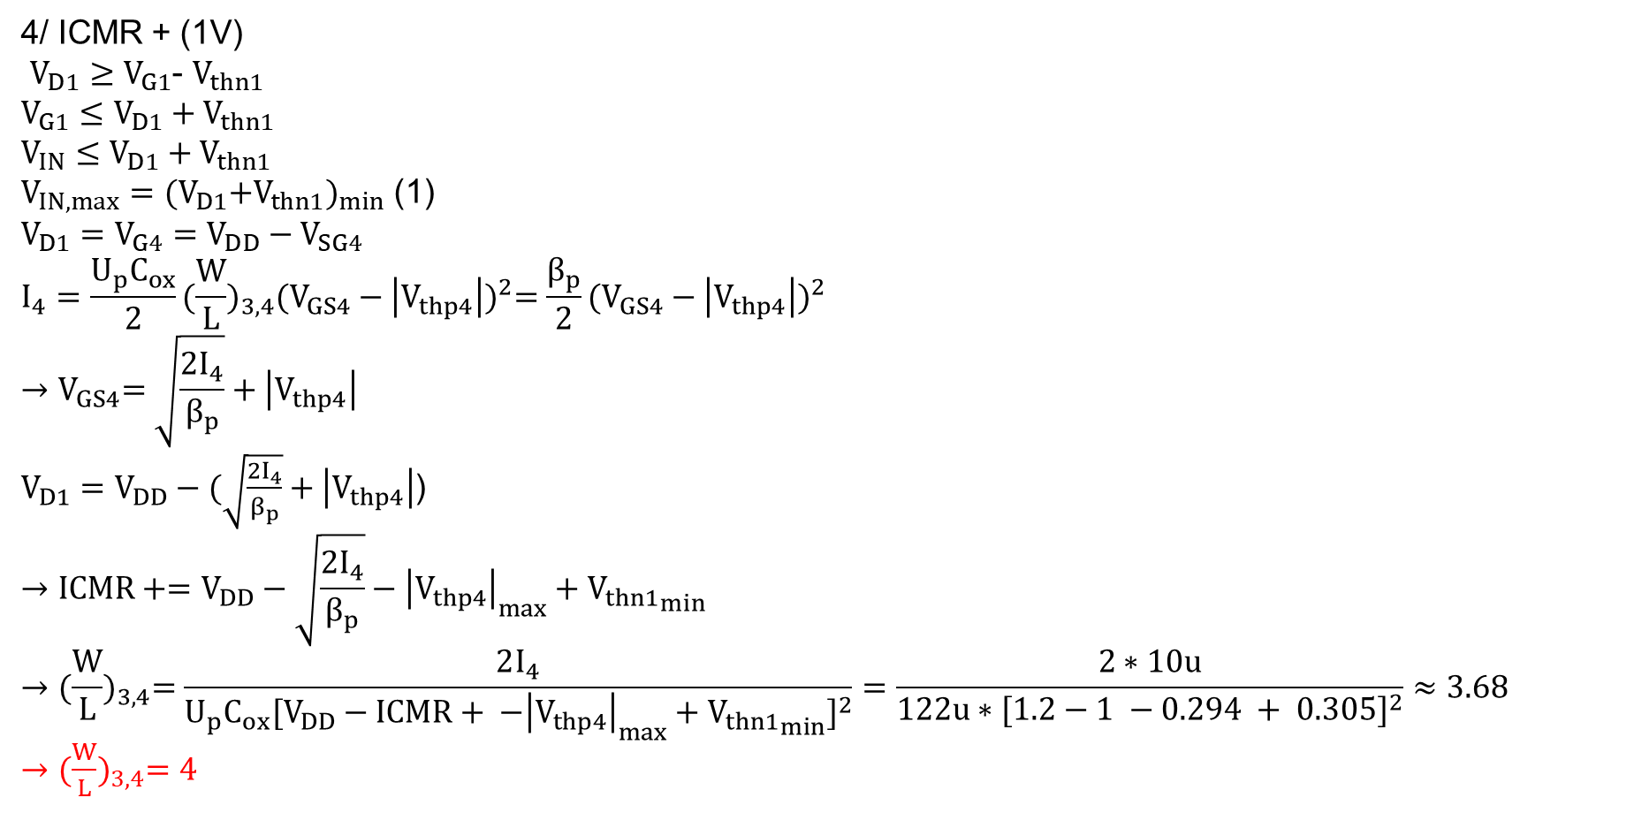
Design Procedure
4/ ICMR + (1V)
$V_{D1}≥V_{G1}$- $V_{thn1}$
$$V_{G1}≤V_{D1}+V_{thn1}$$
$$V_{IN}≤V_{D1}+V_{thn1}$$
$V_{IN,max}={{(V}_{D1}+V_{thn1})}_{min}$ (1)
$$V_{D1}=V_{G4}=V_{DD}−V_{SG4}$$
$$I_{4}=\frac{U_{p}C_{ox}}{2}{(\frac{W}{L})}_{3,4}{(V_{GS4}−\left|V_{thp4}\right|)}^{2}=\frac{β_{p}}{2}{(V_{GS4}−\left|V_{thp4}\right|)}^{2}$$
$${→V}_{GS4}=\sqrt{\frac{2I_{4}}{β_{p}}}+\left|V_{thp4}\right|$$
$V_{D1}=V_{DD}−(\sqrt{\frac{2I_{4}}{β_{p}}}+\left|V_{thp4}\right|$)
$$→ICMR+=V_{DD}−\sqrt{\frac{2I_{4}}{β_{p}}}−{\left|V_{thp4}\right|}_{max}+{V_{thn1}}_{min}$$
$${→(\frac{W}{L})}_{3,4}=\frac{2I_{4}}{U_{p}C_{ox}{[V_{DD}−ICMR+ {−\left|V_{thp4}\right|}_{max}+{V_{thn1}}_{min}]}^{2}}=\frac{2∗10u}{122u∗{[1.2−1 −0.294 + 0.305]}^{2}}≈3.68$$
${→(\frac{W}{L})}_{3,4}=4$

Slide 10
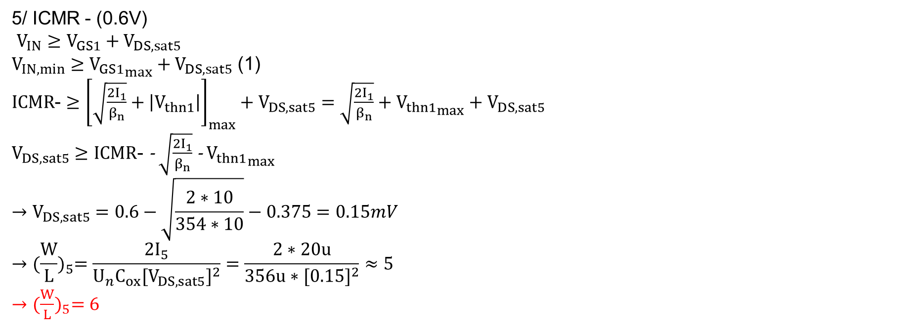
Design Procedure
5/ ICMR - (0.6V)
$V_{IN}≥V_{GS1}+V_{DS,sat5}$
$V_{IN,min}≥{V_{GS1}}_{max}+V_{DS,sat5}$ (1)
$ICMR$- $≥$ ${\left[\sqrt{\frac{2I_{1}}{β_{n}}}+\left|V_{thn1}\right|\right]}_{max}+V_{DS,sat5}=\sqrt{\frac{2I_{1}}{β_{n}}}+{V_{thn1}}_{max}+$ $V_{DS,sat5}$
$V_{DS,sat5}≥ICMR\text{−}$- $\sqrt{\frac{2I_{1}}{β_{n}}}$ - ${V_{thn1}}_{max}$
$$→V_{DS,sat5}=0.6−\sqrt{\frac{2∗10}{354∗10}}−0.375=0.15mV$$
$${→(\frac{W}{L})}_{5}=\frac{2I_{5}}{U_{n}C_{ox}{[V_{DS,sat5}]}^{2}}=\frac{2∗20u}{356u∗{[0.15]}^{2}}≈5$$
${→(\frac{W}{L})}_{5}=6$

Slide 11
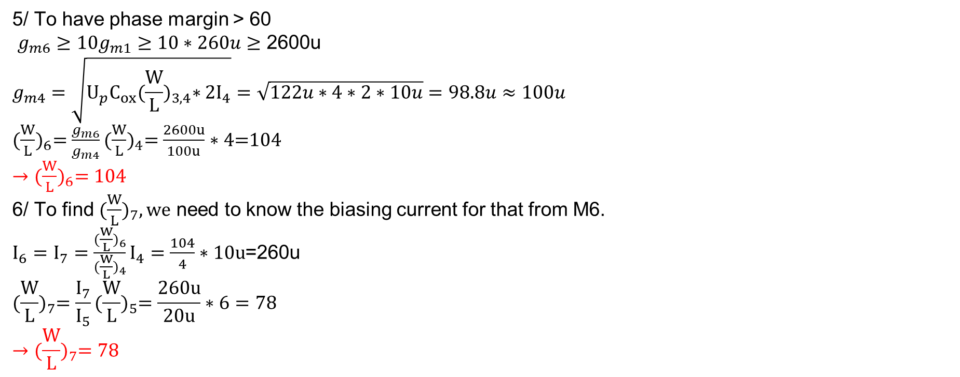
Design Procedure
5/ To have phase margin > 60
$g_{m6}≥{10g}_{m1}$ $≥10∗260u$ $≥$ 2600u
$$g_{m4}=\sqrt{U_{p}C_{ox}{(\frac{W}{L})}_{3,4}∗2I_{4}}=\sqrt{122u∗4∗2∗10u}=98.8u≈100u$$
${(\frac{W}{L})}_{6}=\frac{g_{m6}}{g_{m4}}{(\frac{W}{L})}_{4}=\frac{2600u}{100u}∗4$=104
${→(\frac{W}{L})}_{6}=104$
6/ To find ${(\frac{W}{L})}_{7}, we$ need to know the biasing current for that from M6.
$I_{6}=I_{7}=\frac{{(\frac{W}{L})}_{6}}{{(\frac{W}{L})}_{4}}I_{4}=\frac{104}{4}∗10u$=260u
$${(\frac{W}{L})}_{7}=\frac{I_{7}}{I_{5}}{(\frac{W}{L})}_{5}=\frac{260u}{20u}∗6=78$$
$${→(\frac{W}{L})}_{7}=78$$

Slide 12
Schematic with W/L ratio
I choose L=1um for all mos
W=4u
L=1u
W=104u
L=1u
W=4u
L=1u
W=10u
L=1u
W=10u
L=1u
W=6u
L=1u
W=6u
L=1u
W=78u
L=1u

Slide 13
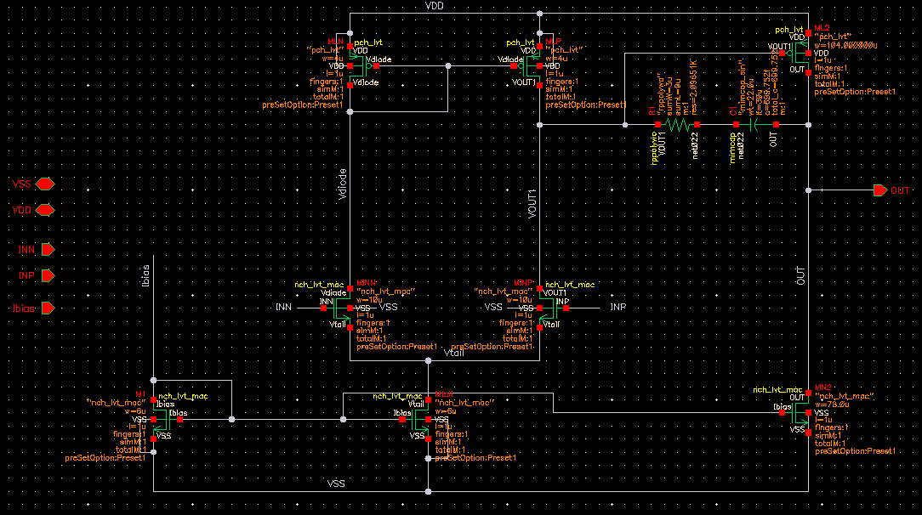
Schematic in Cadence

Slide 14
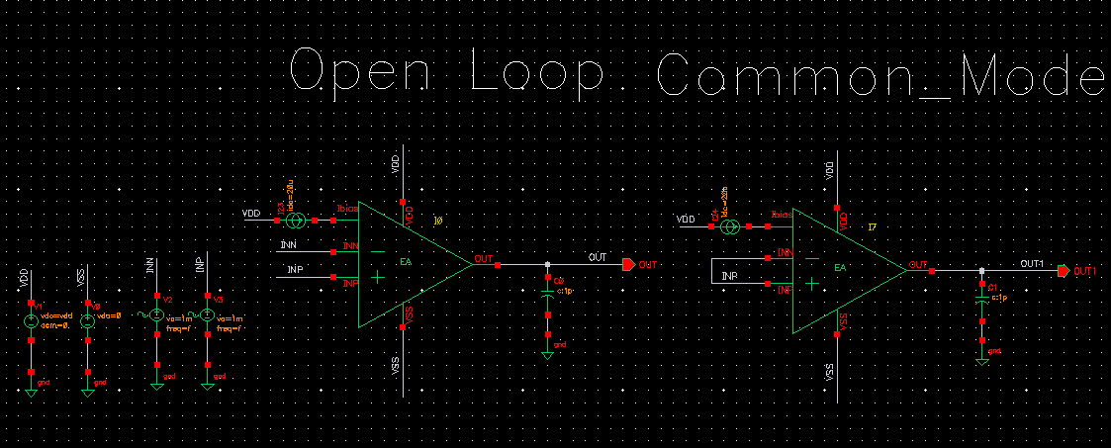
Testbench in Cadence

Slide 15
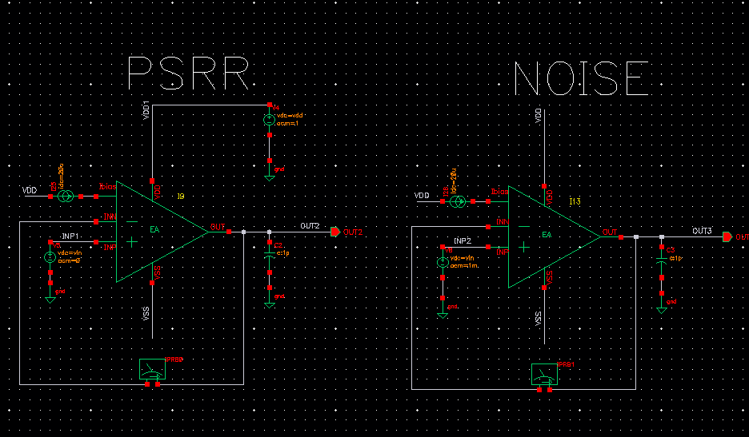
Testbench in Cadence

Slide 16
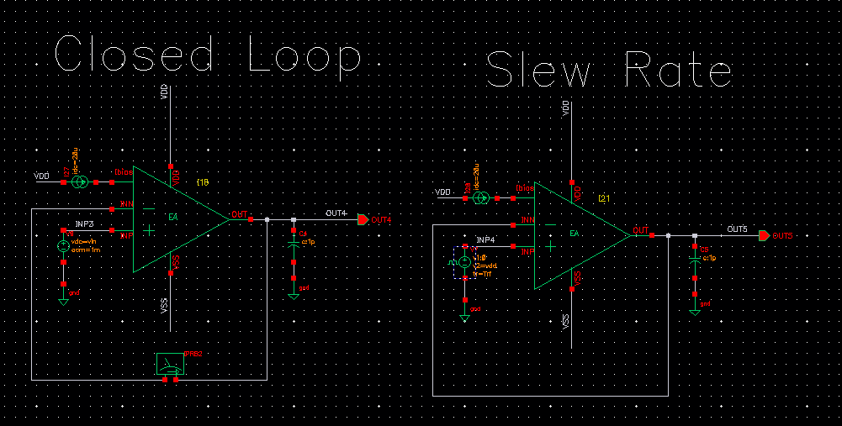
Testbench in Cadence

Slide 17
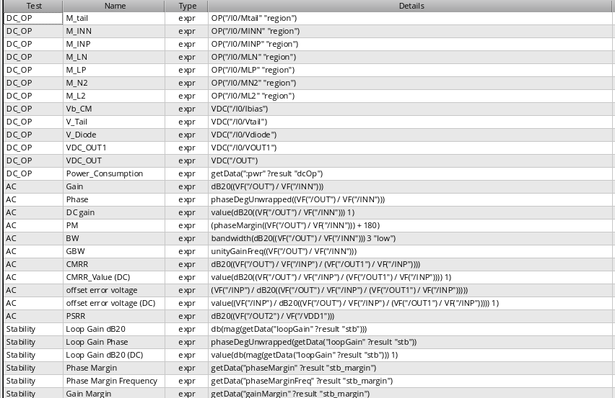
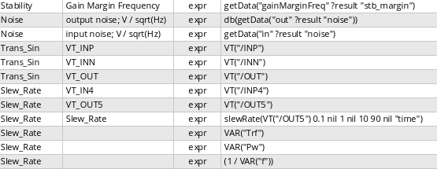
Testbench in Cadence

Slide 18
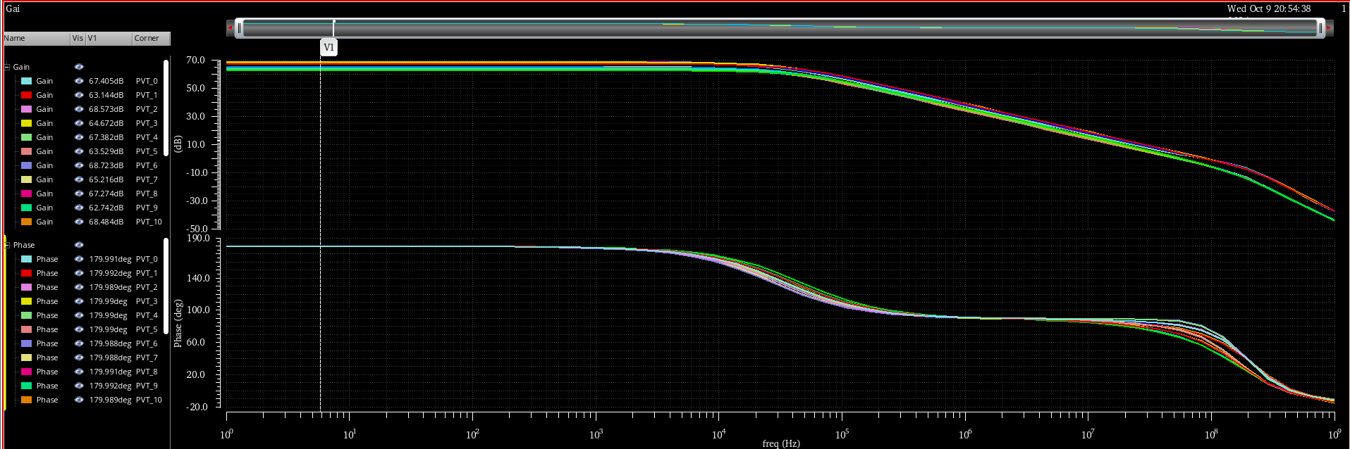
Open loop Gain

Slide 19
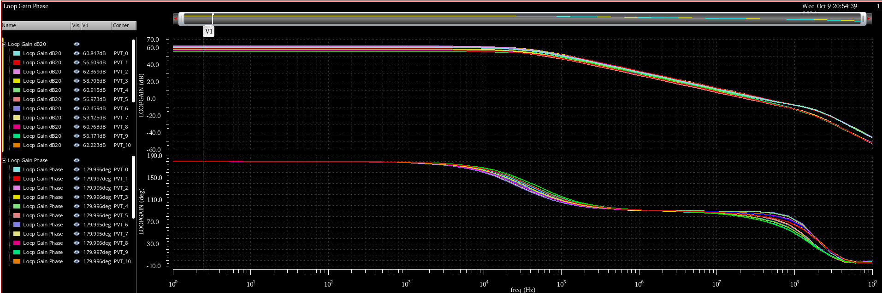
Closed loop Gain

Slide 20
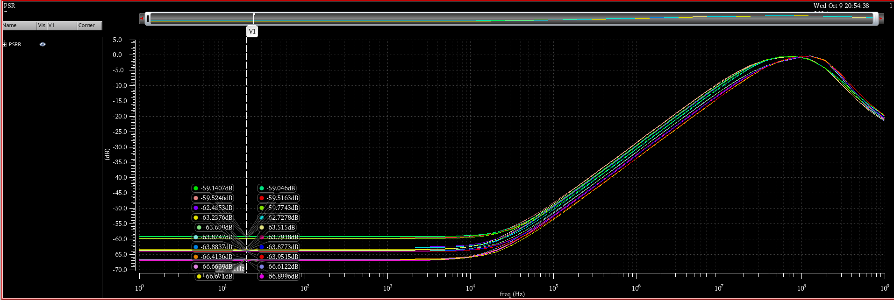
PSRR

Slide 21
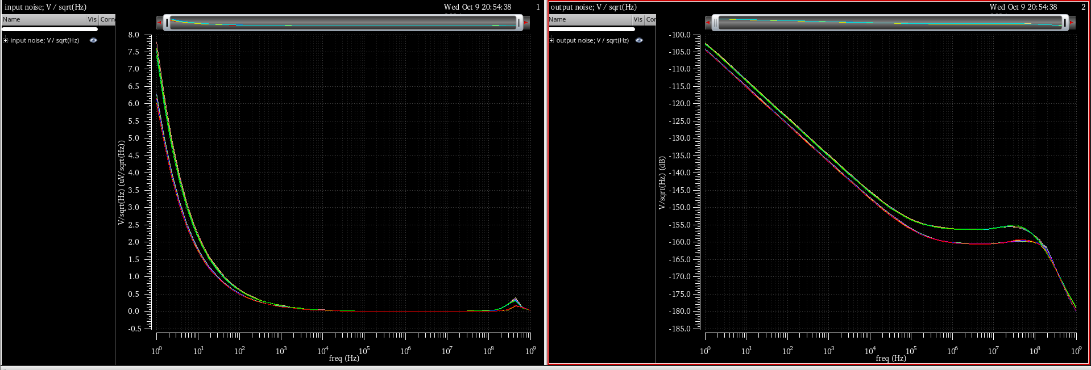
Noise

Slide 22
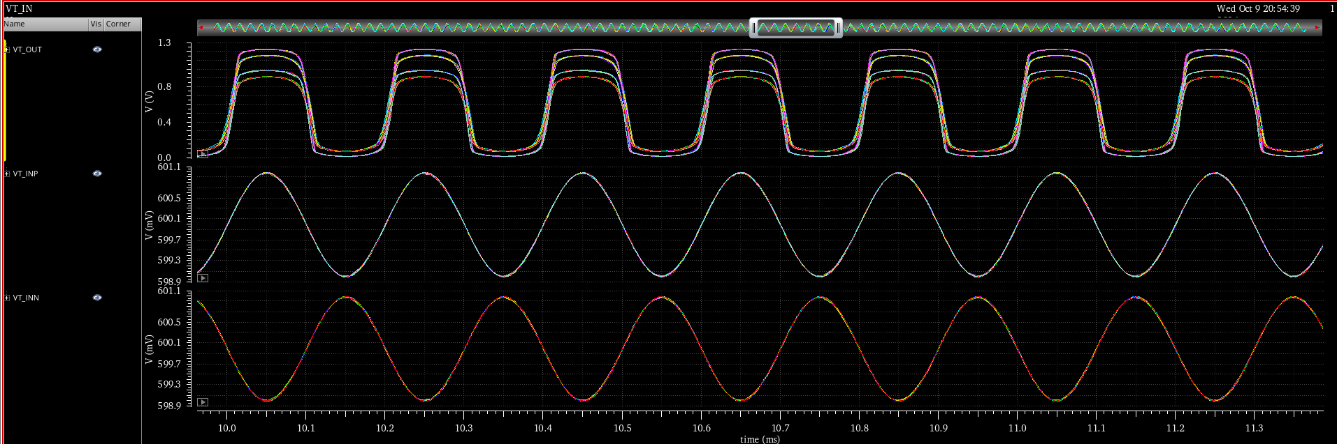
Tranient Swing

Slide 23
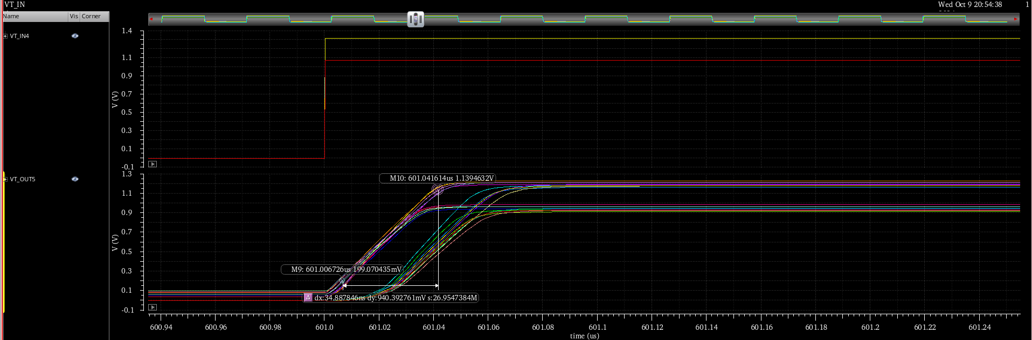
Slew rate

Slide 24
Result
Design specification |  | Min | Max | Typical | Test condition
Opened-loop gain |  | 62.64dB | 68.72dB | 67.04dB | In CM = 0.6
CMRR (single-ended) |  | 89.35 dB | 102.05dB | 69.88
Slew rate |  | 15.11V/uS | 31.15V/uS | 27V/uS
Unity gain BW | 1p | 52.75MHz | 96.73MHz | 74.32MHz
Phase Margin | 1p | 66.02 deg | 79.2 deg | 73.09 degree
Closed-loop gain |  | 56.17dB | 62.49dB | 60.75dB
ICMR |  | - | - | 0.5V to 1V | TTNN corner

Slide 25
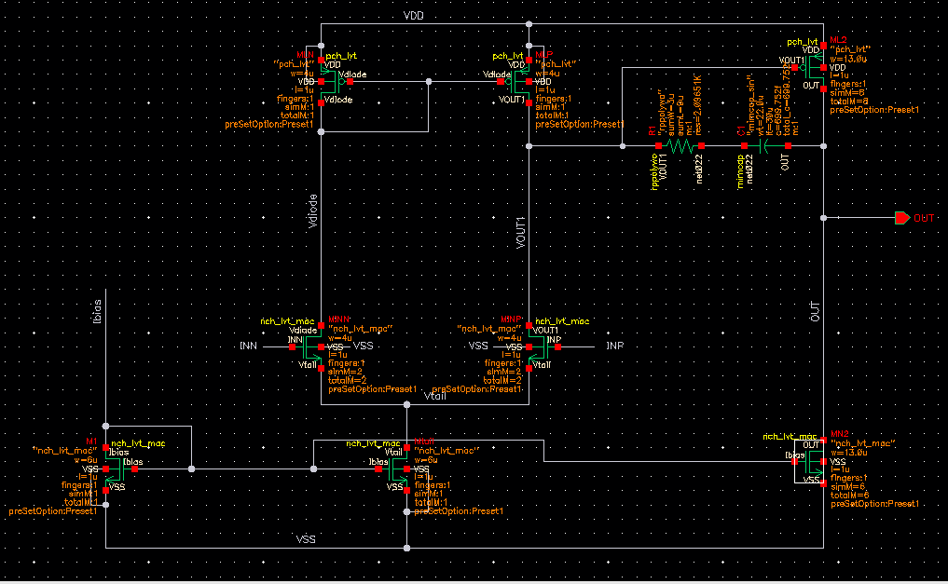
Schematic for Layout

Slide 26
Result pre layout
Design specification |  | Min | Max | Typical | Test condition
Opened-loop gain |  | 62.64dB | 68.72dB | 67.04dB | In CM = 0.6
CMRR (single-ended) |  | 89.35 dB | 102.05dB | 69.88
Slew rate |  | 15.11V/uS | 31.15MV/uS | 27V/uS
Unity gain BW | 1p | 52.75MHz | 96.73MHz | 74.32MHz
Phase Margin | 1p | 66.02 deg | 79.2 deg | 73.09 degree
Closed-loop gain |  | 56.17dB | 62.49dB | 60.75dB
ICMR |  | - | - | 0.5V to 1V | TTNN corner

Slide 27
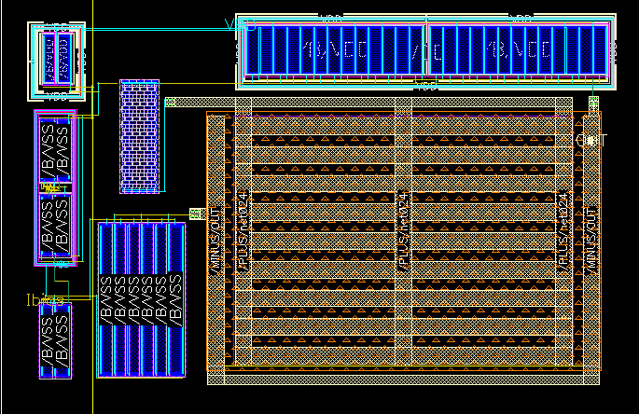
Layout
NMOS Current load stage 2
PMOS Curent load stage 1
NMOS Diffpair stage 1
NMOS Current miror stage 1
NMOS Current miror stage 2

Slide 28
Reference
[1] Low Dropout Regulators, Pavan Kumar Hanumolu University of Illinois, Urbana-Champaign, P. Hanumolu CICC 2015

Slide 29
Next week plan and schedule
Reading book from chapter 4

Slide 30
Thank you

